Slide 1

DX University
Visalia California – 2015

Slide 2
A New View of Gray Line Propagation
. . . and several more topics . . .
Carl Luetzelschwab K9LA

Slide 3
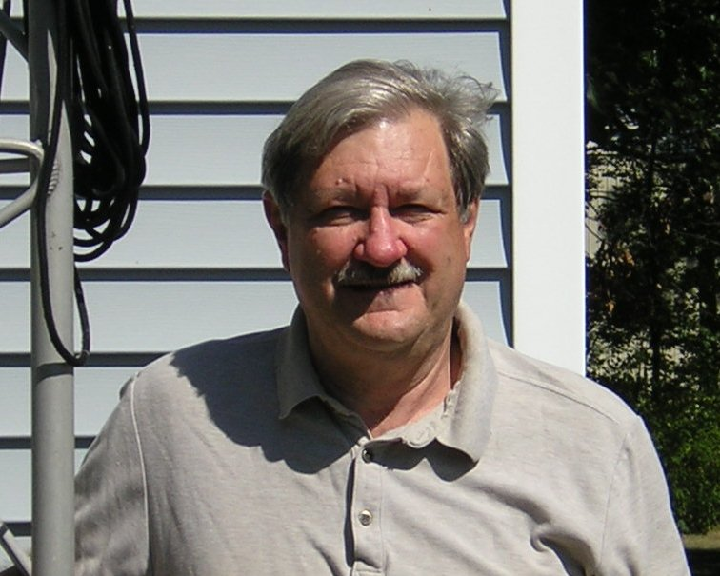
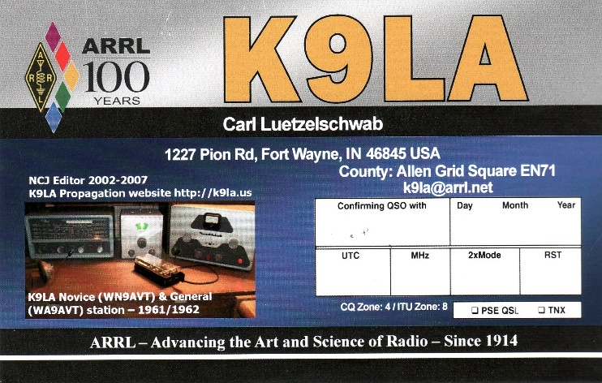
Carl Luetzelschwab K9LA
First licensed in 1961, began DXing in 1979. Enjoys propagation, DXing, contesting, antennas and vintage equipment.
Top of the Honor Roll, 5BDXCC, 160m DXCC, need 6 zones on 80m for 5BWAZ.
DXpeditions: YK9A in February 2001, OJ0/K9LA in July 2002, many operations from ZF as ZF2LA and ZF1A.
President of the Fort Wayne DX Association (FWDXA), retired RF design engineer for Motorola (1974-1988) and Raytheon (1988-2013, formerly Magnavox).
You can contact Carl at k9la@arrl.net

Slide 4
Topics
Quick review of previous year’s presentations
Alternate explanation for gray line propagation
Cycle 24 status
What’s going on with 160m?
What’s It Take for 6m F₂ to happen?

Slide 5
Previous Year’s Presentations
K9LA DXU Visalia 2012, 2013, 2014
Covered
  basics of the ionosphere
  propagation predictions
  interpreting space weather
  best antenna height
  real-time assessment of the bands
  when to work DX
  which way to point antenna
  disturbances to propagation
All three presentations are available at http://k9la.us under the DXU link on the left

Slide 6
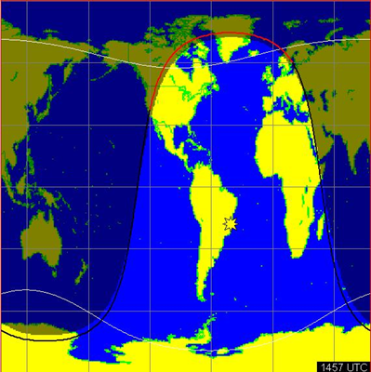
Gray Line Propagation
The concept of gray line propagation began with the article titled The “Gray Line” Method of DXing by K6UA, W6NLZ, K6SSS in the September 1975 CQ
  80m SSB from W6 to EU
  Example - W6NLZ to OJ0AM
    Jan 28, 1974 at 1457 UTC
thanks W6ELProp
Explanation for gray line
  Little or no absorption along the terminator
  Based solely on observations and antenna directions
Doubts crept into my mind
  My QSO with YB1A on 40m
  Ever hear of a short path gray line QSO?
long path

Slide 7
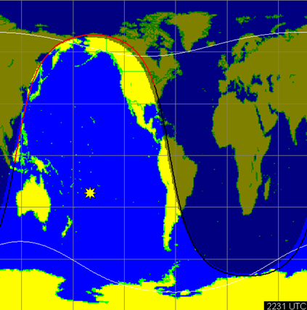
K9LA to YB1A
thanks W6ELProp
Dec 3, 2002 at 2231 UTC
YB1A was S8 = -78 dBm
  My S-meter is calibrated
My antenna was an inv-vee
  Can’t tell short or long path
  Most DXers would say lp
IONCAP says
  -180 dBm lp (1kW & 0 dBi)
  -133 dBm sp (1kW & 0 dBi)
Even assuming short path, is IONCAP off by 52 dB?
long path

Slide 8
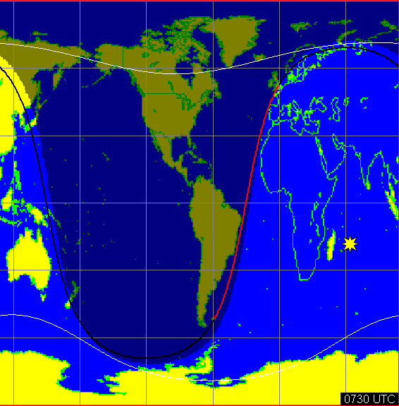
Gray Line QSO via Short Path?
G0KYA monitored a VP8 Falkland Islands beacon via short path on 40m and 80m around mutual sunrise and sunset
thanks W6ELProp
At times he saw small enhancements (several dB) about 30 minutes before the terminator aligned with the short path – but no significant enhancements seen when the terminator aligned with the path
G
VP8
If there’s an alleged long path enhancement, why isn’t there a short path enhancement?

Slide 9
The Big Question
Is propagation along the terminator on the low bands efficient as is commonly believed?
Based on our understanding of ionospheric physics, I don’t believe so.
What else happens when W6NLZ and OJ0AM experience simultaneous sunrise and sunset?
  There’s a dark ionosphere in between them
thanks W6ELProp

Slide 10
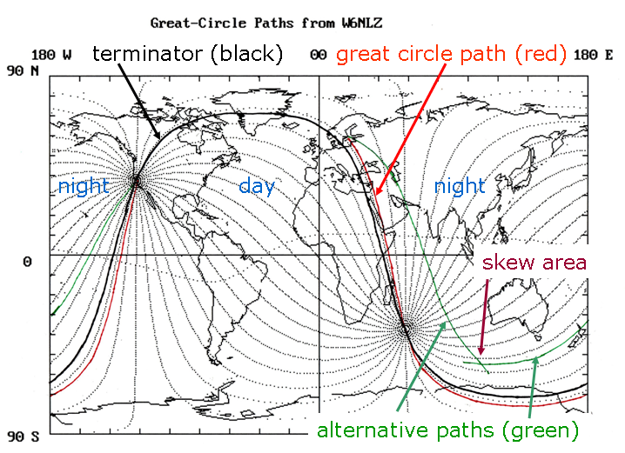
Alternative Explanation
Dark ionosphere
  Least absorption
  Electron density valley above E region peak for ducting
Involves two great circle paths
  Requires the RF to skew off one gcp and onto the other
  Skew likely due to auroral zone, trough, irregularity
SW at sunrise and SE at sunset still apply – we’re just getting away from the terminator into the dark ionosphere quicker

Slide 11
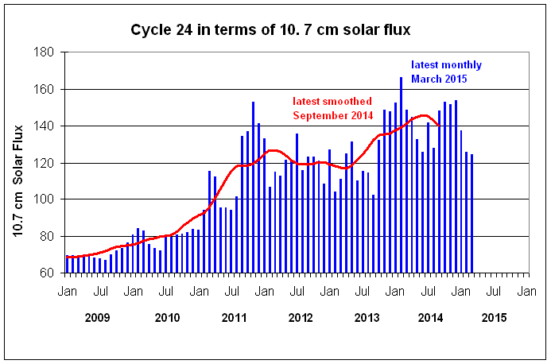
Cycle 24 Status
it looks like Cycle 24 has begun its descent

Slide 12
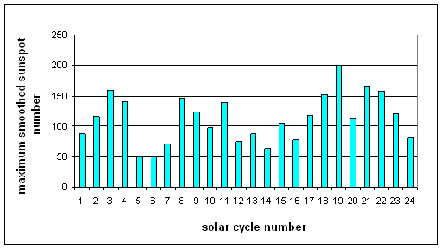
Long Term Look to the Future
Three periods of high solar activity
Two periods of low solar activity
And we’re headed towards . . . . .

Slide 13
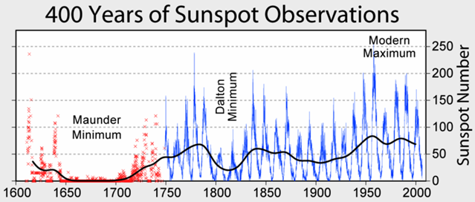
Another Maunder Minimum?
70 year period of very few sunspots
~ 1645-1715

Slide 14
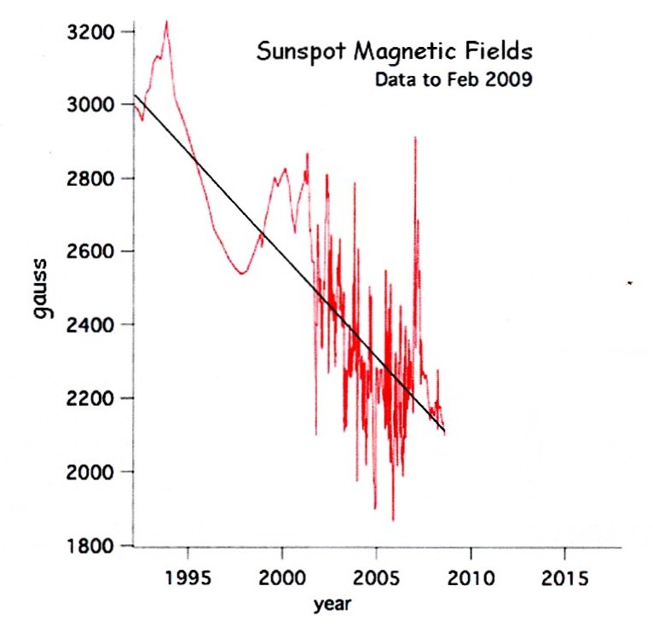
Maunder Minimum Fueled by This Data
July 2009 paper by Livingston and Penn
Fact: sunspots visible when their magnetic field strength > 1500 Gauss
Extrapolation: no sunspots will be seen sometime after 2015

Slide 15
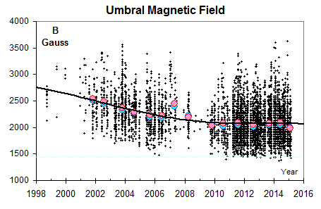
Update Through Present
Decrease has stopped – for now!
Next few years will be interesting to watch
Caused degradation in extremely high correlation between R₁₂ and F₁₂ after 2nd peak of Cycle 23

Slide 16
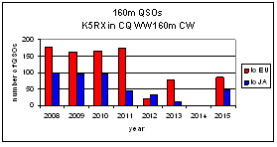
What’s Going On With 160-Meters?
General consensus appears to be “160m isn’t too good”
Well, it should be bad – we’re at solar max
  An old adage: 160m good at solar min, bad at solar max
  Absorption a bit more at solar max and long distances on 1.8 MHz can’t tolerate much more absorption
How much of this is a human factor – is 160m a self-fulfilling prophecy?
But Cycle 24 is the smallest since Cycle 16 (max 78 in 1928)

Slide 17
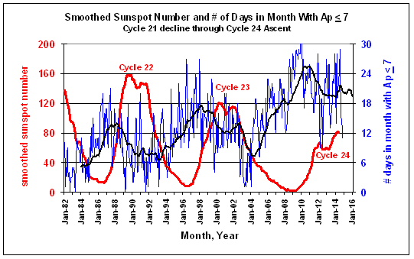
Earth’s Magnetic Field is Very Quiet
We have a solar max that in one aspect looks like a solar min
With the magnetic field so quiet, why isn’t 160-Meters better?

Slide 18
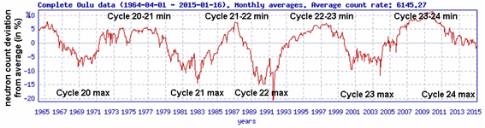
Maybe It’s Too Quiet
Could galactic cosmic rays (GCRs) be a problem?
  At a “normal” solar max, the Sun’s magnetic field keeps GCRs out
  At solar minimum, GCRs are let in
GCRs mostly very energetic protons
  Cause a secondary shower of particles that causes additional ionization down low in the atmosphere

Slide 19
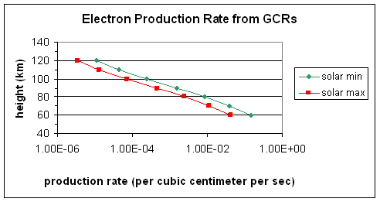
GCR Electron Production Rate
with a quieter magnetic field, higher production rate

Slide 20
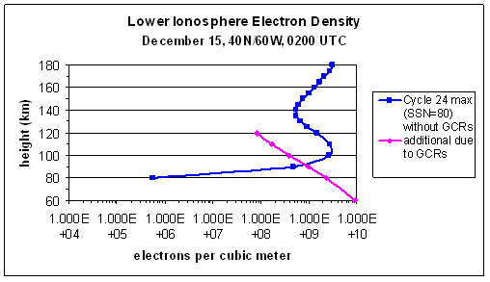
Additional Ionization Due to GCRs
Additional ionization by GCRs on the order of magnitude of ionization in the absorbing region of the nighttime ionosphere
Perhaps the Sun’s magnetic field is too quiet for 160-Meters

Slide 21
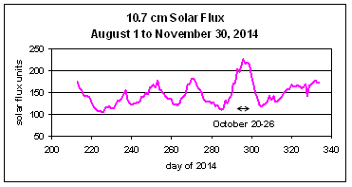
And Now for the Other End of the Spectrum
Another old adage: Watch for 6-Meter F₂ propagation when the 10.7 cm solar flux is above 200
Why wasn’t 6m F2 available in late October 2014?
We’ll look at four issues
  Correlation between 10.7 cm sf and true ionizing radiation
  Time of year
  Other parameters affecting ionization
  Our understanding of the ionosphere-Sun correlation

Slide 22
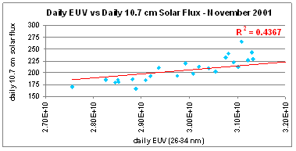
10.7 cm SF and True Ionizing Radiation
10.7 cm solar flux and sunspots are a proxy for the true ionizing radiation
For the F₂ region, true ionizing radiation is at wavelengths between 10-100 nm (EUV)
There certainly is a correlation
  The higher the solar flux, the higher the EUV
  But for a given 10.7 cm solar flux value, there is not a unique EUV

Slide 23
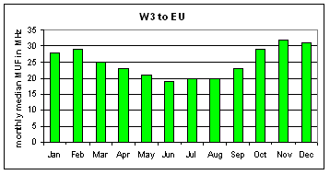
Time of the Year
MUF throughout the year from W3 to EU at a constant value of ionizing radiation
In the northern hemisphere, the fall and winter months are the best for producing the highest amount of ionization

Slide 24
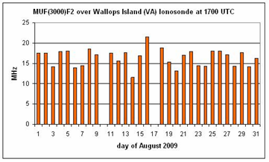
Other Factors Affecting Ionization
Here’s the MUF for a 3000 km hop over the Wallops Island ionosonde during August 2009
August 2009
  Constant 10.7 cm solar flux (around 67)
  Zero sunspots
  Low A indices
MUF varied by about a 2:1 ratio
Geomagnetic field activity and meteorological events in the lower atmosphere contribute to (in other words, rearrange) the amount of ionization

Slide 25
The Ionosphere-Sun Correlation
So how do we model the 2:1 variability of the ionosphere seen on the plot on the previous page when the solar radiation is constant?
We can’t do it with a daily model
We do it with a longer-term statistical model
  Monthly median ionospheric parameters are correlated to a smoothed solar index
  This is the model our propagation predictions use
  Model is statistical over a month’s time frame
Let’s take a longer-term look at October 2014 in relation to 6-Meters – along with November months

Slide 26
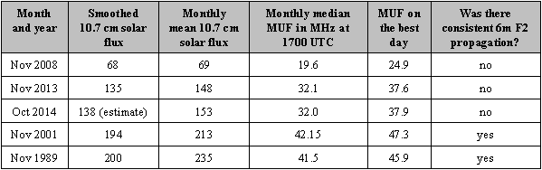
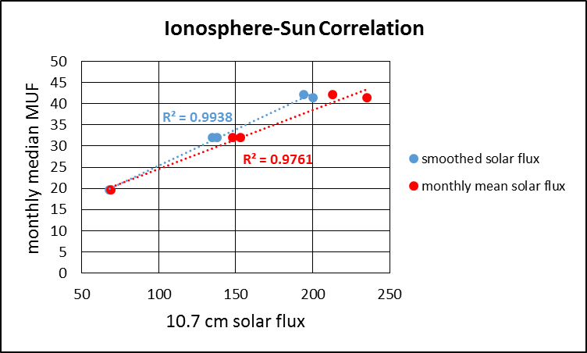
Ionosphere vs Solar Radiation
Boulder, 3000 km MUF, 1700 UTC
Although the smoothed sf gives the best correlation to the monthly median MUF, the monthly mean sf gives a decent correlation to the monthly median MUF
Thus use the monthly mean solar flux to judge if 6m F₂ is possible

Slide 27
Summary for 6-Meters
The amount of 10.7 cm solar flux must correspond to a high EUV value
  Somewhat irrelevant if we use a longer-term sf value
The high EUV must occur in a fall or winter month
Geomagnetic field activity and meteorological events in the lower atmosphere must maximize ionization
A high amount of EUV must impinge on the atmosphere for more than just several days
  Monthly mean solar flux will give a better assessment
Lastly, we have to assume hops greater than 3000 km
  4000 km (and greater) hops at 50 MHz are not unusual
  4000 km MUF is ~ 10% higher than the 3000 km MUF

Slide 28
We Covered Many Topics
Reviewed an alternate explanation for gray line propagation on the low bands
  Brings together our on-the-air observations and our understanding of the physics of the ionosphere
Reviewed the current status of Cycle 24 and looked a bit into the future
  Cycle 24 appears to be taking us into uncharted territory
  Cycle 25 will likely be low – after that it’s anyone’s guess!
Investigated why 160-Meters hasn’t been good
  Is the Sun’s magnetic field too quiet, thereby letting in too many GCRs, and resulting too much absorption?
Gave fundamental guidelines to assess 6-Meter F₂ propagation in the northern hemisphere

